Slide 1
Outreach at
Jefferson Lab
Nov 16, 2009
Women in Physics and Engineering Workshop
Jefferson Lab
Nov 16-17, 2009

Slide 2
Outline
K - 12 Outreach
Undergraduates
Graduate Students
Postdocs
Women at Jefferson Lab
Path Forward
Summary

Slide 3
Science Education at Jefferson Lab
Goals:
Expand our strong relationship with the local community through Lab events and partnerships that promote math and science education
Immerse undergraduate and high school students in a world-class facility research environment to mentor the nation’s next generation of leaders
Make a tangible difference in the quality of instruction by providing Lab-related resources for K-12 teachers
Increase the number of women and minorities in science and engineering
Education Office is headed by Jan Tyler

Slide 4
K - 12 Programs
  BEAMS - Becoming Enthusiastic About Math and Science
  Virginia Regional Science Bowls (24 high schools, 22 middle schools)
  Physics Fests (5,000 students)
  Numerous school programs and workshops
  High School Summer Honors Program
    8 interns in summer 2009
    More than 12,000 students have been involved

Slide 5
BEAMS
Becoming Enthusiastic About Math and Science
6th to 8th grade students
  For five consecutive days during school hours, classes of 6th grade students and their teachers participate in science and math activities conducted with Jefferson Lab staff.
  The students return to the lab in the 7th and 8th grades for additional activities which reinforce their 6th grade experience
Goals
    redress the problem that minorities and females are lost from the science, mathematics, engineering and technology career pipeline long before they reach college
    strengthen the motivation and academic preparation of students so they graduate from high school as scientifically literate citizens ready for further education or a worthwhile career

Slide 6
BEAMS is a National Model
Targets 1,400 inner city students and 60 teachers
Showcased in the "Best Practices for Communicating Science to the Public” (DOE Office of Science, NIST, and the U.S. Department of Commerce publication, October 2003)
Highlighted by the National Academy of Sciences' RISE (Resources for Involving Scientists in Education) project as an example of involving scientists in educational outreach programs
One of twenty-five education programs highlighted in the “Best Practices” brochure published by the NSAC Subcommittee on Education (January 2007)
Cited as a national model for science education by Dr. Raymond Orbach, DOE Undersecretary for Science, at the March 2007 NSAC meeting

Slide 7
Professional Development for Teachers
Academies Creating Teacher Scientists (ACTS)
Summer classroom and research program for K-12 teachers at DOE national laboratories
Program Components:
  A commitment by teachers to spend three consecutive summers at a DOE national laboratory
  A rigorous course in basic science taught by an expert teacher from a local high school
  Lectures on current research by JLab scientific staff
  Experiential learning under the guidance of Jefferson Lab technical staff
  Workshops on effective teaching methods for the physical sciences by JLab education staff and community experts

Slide 8
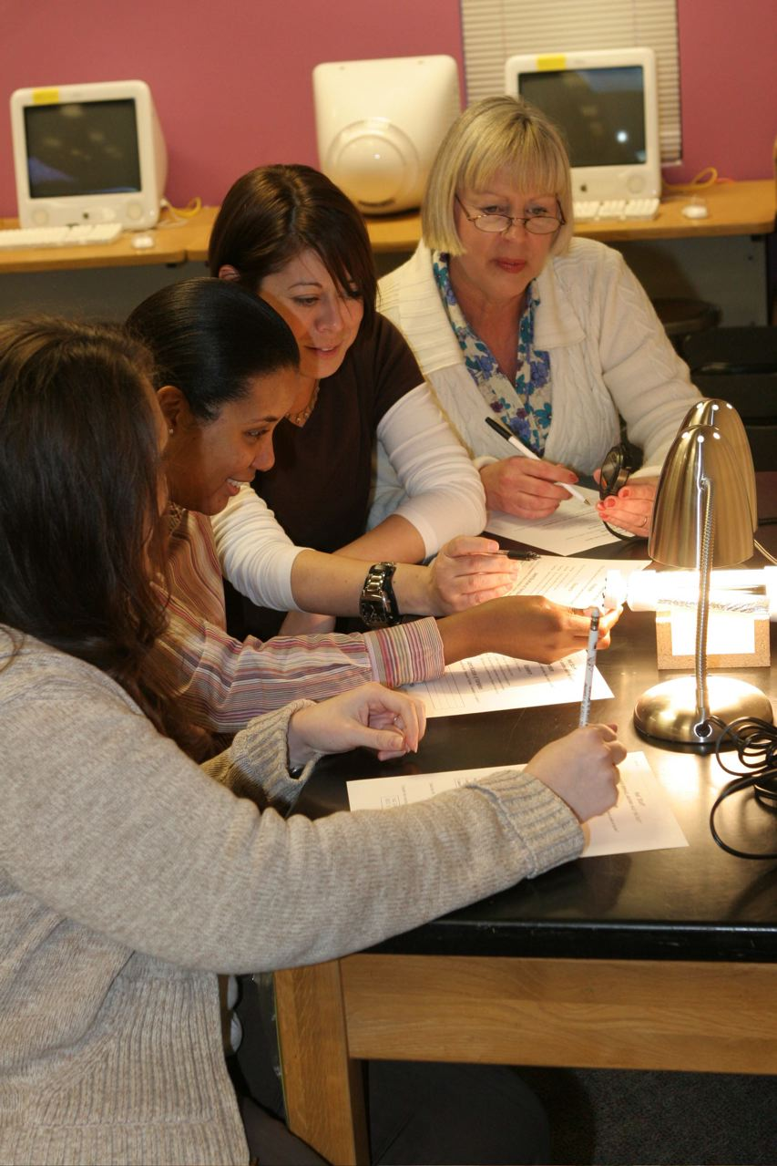
High Demand for ACTS → JSAT
JSAT: JLab Science Activities for Teachers
Places JLab as the community's leader in providing needed professional development for local teachers
Serves an additional 30 teachers per year and, in turn, positively impacts an additional 3,000 students every year
Teachers meet at JLab throughout the school year (18 two-hour sessions)
Similar program content to the ACTS program

Slide 9
Undergraduate Programs
Science Undergraduate Laboratory Internship (SULI) - DOE Program - 16 undergraduates in 2009
Research Experience for Undergraduates - NSF Programs based at local universities
Future Graduate Students, Scientists and Professors
Recruiting qualified undergraduates is the start
Retaining them is a continuing process
  Mentoring
  Female Scientists as role models
  Creating a conducive environment
JLAB has an excellent Education Office

Slide 10
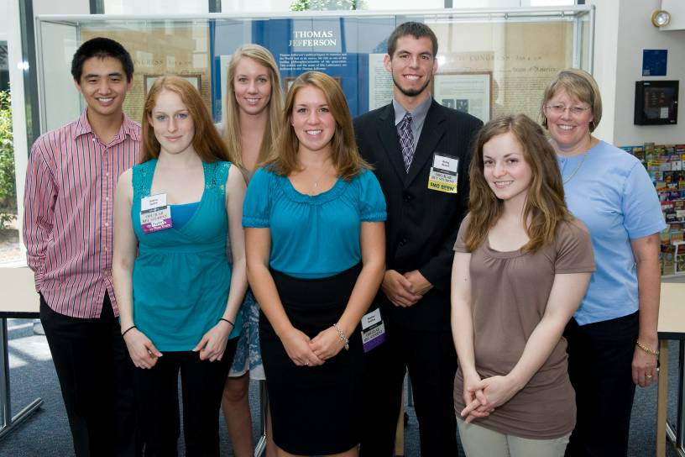
Undergraduate Programs
Goal is to engage undergraduates during school year to continue on their summer research projects
  Support for presenting poster at conference
  Support for continuing research
  Needs modest amount of money
  Use JSA initiatives to support the best qualified student

Slide 11
There are many graduate students, both permanent and visiting, at Jefferson Lab
Graduate Student and Post Doc Association (GSPDA) is active with funding from the JSA initiatives fund
One graduate student representative on the Users Group Board of Directors
Graduate Students

Slide 12
There is no official postdoctoral mentoring program at Jefferson Lab
Postdocs do participate in some of the programs organized by the graduate students (for example, recent panel discussion on careers
There is one postdoc representative on the Users Group Board of Directors
Postdocs

Slide 13
Women at Jefferson Lab
Jefferson Lab
X Engineers
Y Physics and Accelerator Staff
Z Postdocs
Users
X Faculty
Y Postdocs
Z Graduate Students

Slide 14
Beginnings
~ 2 years ago, Dennis Skopik attended the Gender Equity Workshop
Asked how we could foster a family friendly work place
Informal Committee, self-organized
  Gail Dodge (ODU)
  Latifa Elouadrhiri (JLab)
  Dennis Skopik (JLab)
  Hari Areti (JLab)
Jlab’s Education Office (Jan Tyler) would join

Slide 15
Beginnings
Hugh Montgomery, JLab’s director, attended a talk by Cherry Ann Murray on May 2, 2009 at the APS annual meeting in Denver
"Gender/Diversity Equity Best Practices”
Received advice to provide resources to this self-organized group

Slide 16
Beginnings
Gail and Latifa made presentations at Jlab User Meetings
Under Gail’s and Latifa’s leadership 2 meetings were held at the lab. User and staff women were invited.
The meetings were well attended not only by the Physicists and Engineers, but also by women who have interest in this important issue

Slide 17
Initiatives
Funding by the Jefferson Science Associates (JSA) initiatives fund
  Made this workshop possible
  Will enable future initiatives
Lactation Facility
Feasibility of a Day Care Center
A web site (may be a Wiki) to exchange ideas and post events of interest

Slide 18
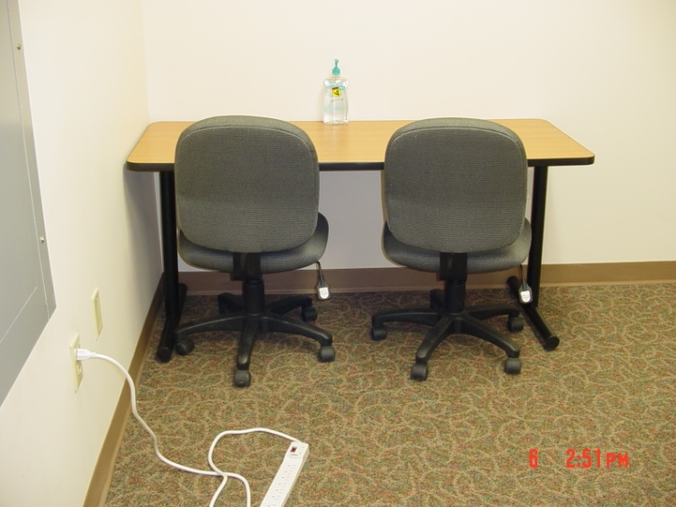
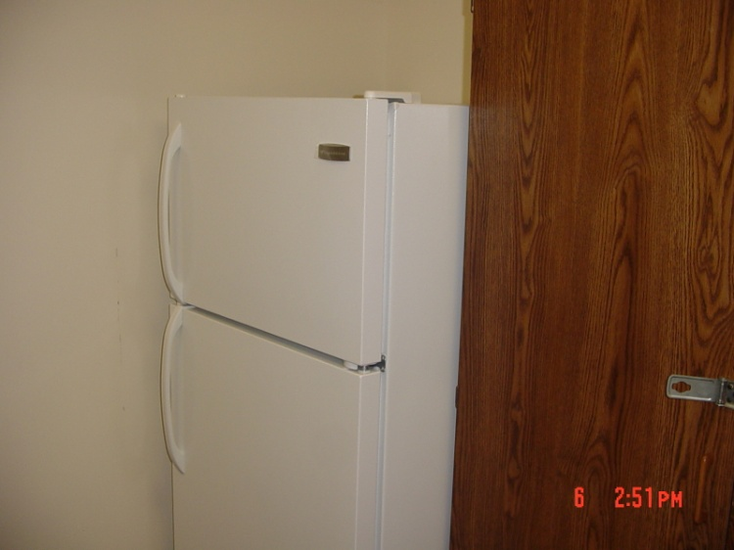
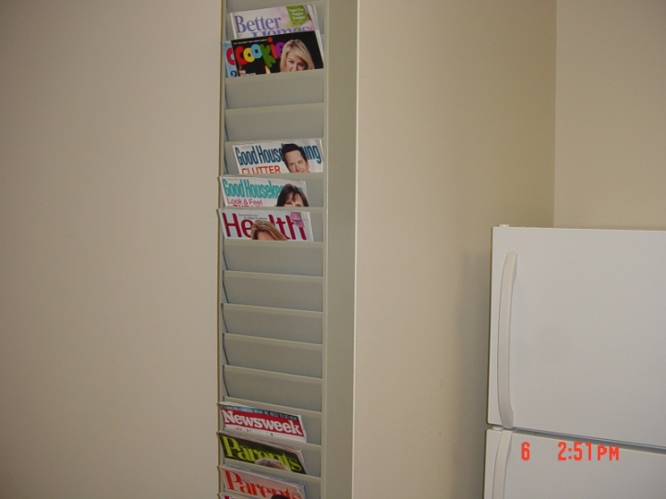
Lactation Facility
Rm F331 in CEBAF’s F-Wing, Key available at User’s Office

Slide 19
Day Care Center
Trying to assess the need of user and staff for a Day Care Center
A day care center near the workplace attracts and retains women
  Users can have their children be safely taken care of while they do experiments, attend conferences and workshops
  Easier for researchers with children participating in scientific activities at the lab
Jefferson Lab had attempted this a few years ago
Funding requested for hiring a person to evaluate
The Physics and Accelerator Divisions will make time available for the PI & Co-PI

Slide 20
Web Site
People are interested in helping create this site
Needs follow up to discuss the content

Slide 21
Retention
Diversity
  University faculty, Lab’s Scientific Staff
Mentoring
  Has to happen at every stage
Collegial
  Seeking and valuing student input in research work
Interesting work
  Course work as well as research work
Engage graduate students and post-docs

Slide 22
Path Forward
Workshops
  Exchange of ideas
  Sharing successful strategies
  Pooling resources
Tapping funding sources
  Child care
  Travel grants for accompanying children
Collaborate
Mentor

Slide 23
FYI
Child Care Grants
http://www.aps.org/meetings/april/services/childcare.cfm
http://www.aps.org/meetings/march/services/childcare.cfm
Small grants of up to $400 are available to assist meeting attendees who are bringing small children or who incur extra expenses in leaving them at home (i.e., extra daycare or babysitting services)

Slide 24
Summary
JLab and User community wish to be more active in fostering gender equity in Physics and Engineering
Working towards providing services for families with children (Lactation Facility in place, need for Day Care Center is being assessed)
Trying to recruit qualified female undergraduates and keep them engaged (has an auspicious start with JSA initiatives and Acc. Division funding an undergraduate)
This workshop
We solicit your advice, ideas and participation

Slide 25
Ph.D.s Earned at Jefferson Lab
98 99 00 01 02 03 04 05 06 07 08 09

